Slide 1
HR ANALYtics Group 7
Mr. Jignesh Patel
Mr. Prakhyati Sweta
Mr. Titto George
Mr. Mohammad Salman Khan
Mr. Amit Mishra
Mr. Akhilesh Pachhel

Slide 2
Dataset Overview
Dataset Name – HR_1,HR_2
Dataset Format – XLSX (excel)
Sheets – 2
Columns – HR1 : 18 columns, HR2 :18 columns
Records – 50000
Modules- EXCEL , MYSQL , POWER BI , TABLEAU

Slide 3
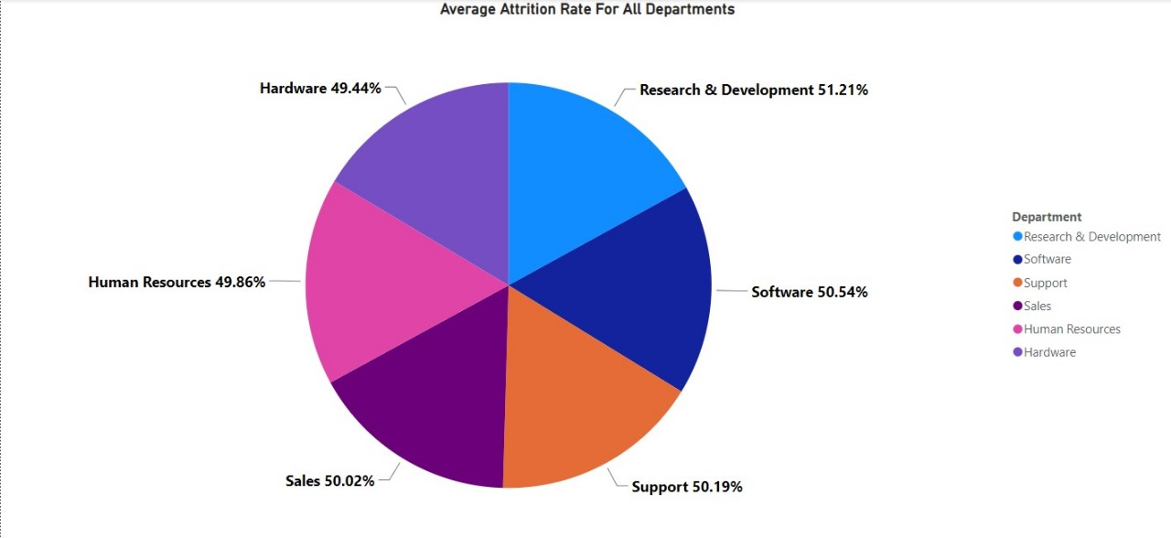
KPI 1 – Average Attrition rate for all Departments
Observation-
In Departments, the Average Attrition Rate is Highest for Research & Development (51.21%).
Followed by Software (50.54%), Support (50.19%), Sales (50.02%), Human Resource (49.86%).
The Lowest Average Attrition Rate is for Hardware (49.44%).

Slide 4
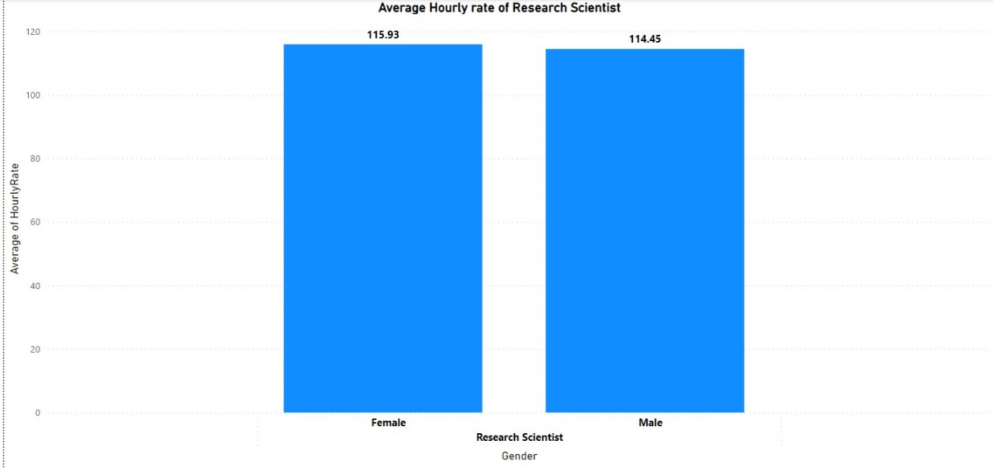
KPI 2 – Average Hourly rate of Male Research Scientist
Observation-
Average Hourly Rate For Male Research Scientist is 114.45.
Average Hourly Rate For Female Research Scientist is 115.93
We can Observe that the Average Hourly Rate for Male Research Scientist is less than Female Research Scientist.

Slide 5
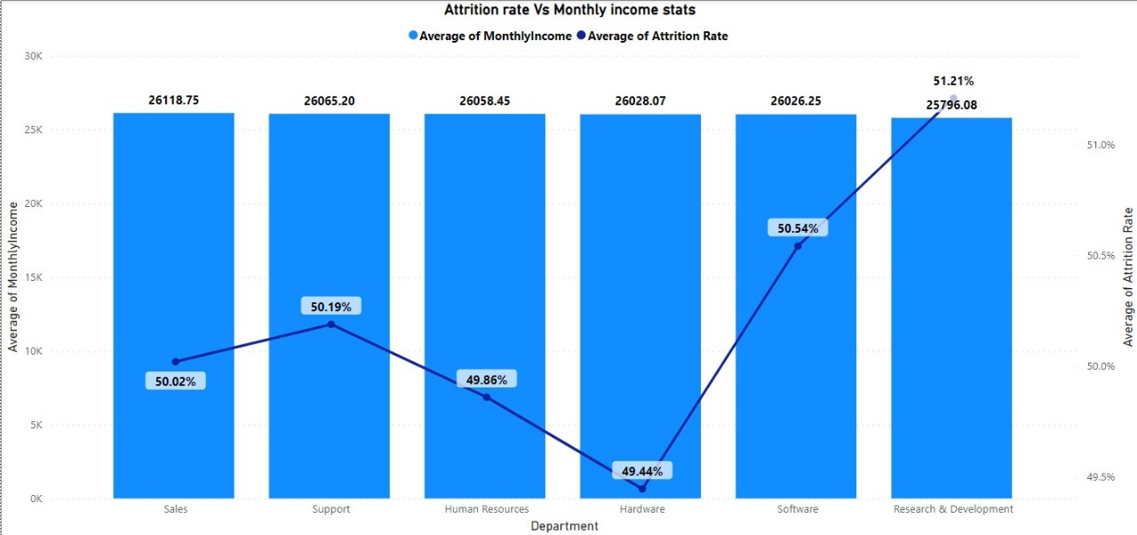
KPI 3 – Attrition rate Vs Monthly income stats
Observation –
Average Monthly Income for all Departments is almost same.
Average Attrition Rate is Lowest for Hardware Department and Highest for Research & Development Department.
We can Observe that Average Monthly Income for Research & Development is Lowest and Average Attrition Rate is Highest.

Slide 6
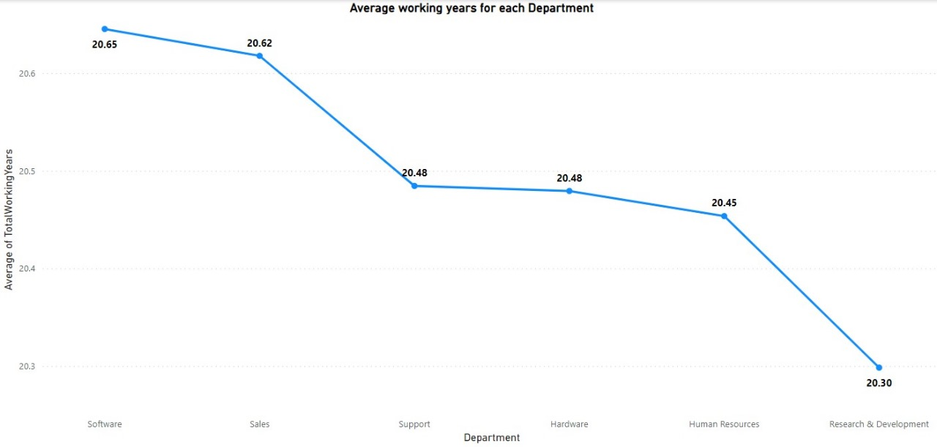
KPI 4 – Average working years for each Department
Observation –
Average Working Years is Highest for Software Department(20.65).
Average Working Years is Lowest for Research & Development Department(20.30).

Slide 7
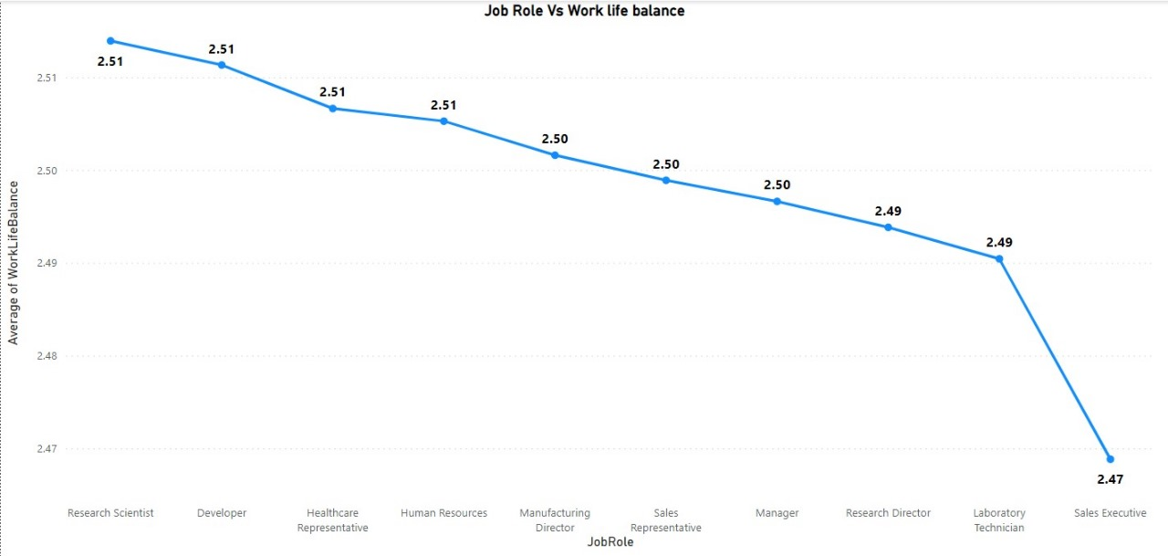
KPI 5 – Job Role Vs Work life balance
Observation –
Work Life Balance is Highest for Research Scientist, Developer, Healthcare Representative & Human Resources i.e. 2.51
Work Life Balance is Lowest for Sales Executive.(2.47)

Slide 8
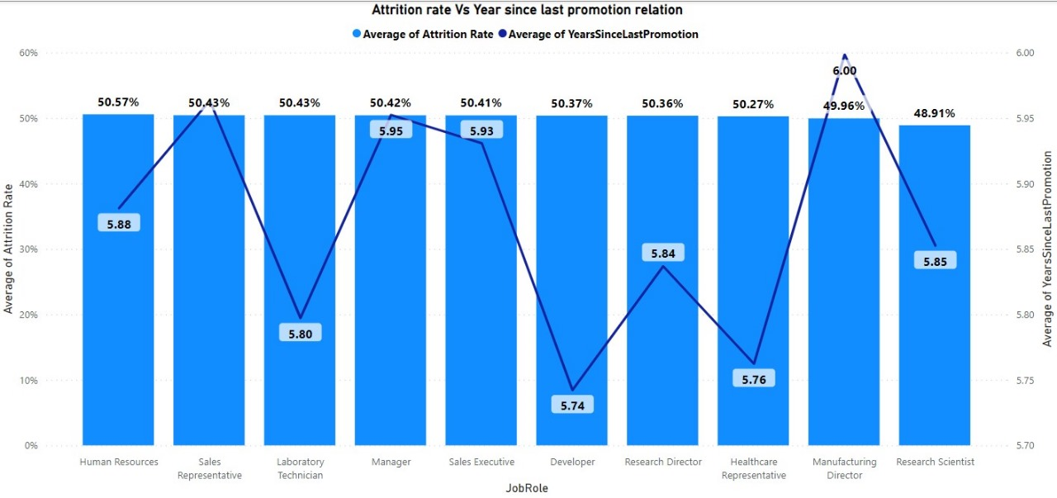
KPI 6 – Attrition rate Vs Year since last promotion relation
Observation –
Average Attrition Rate for all Job roles are almost same.
Average Year Since Last Promotion is lowest for Developer(5.76) & Highest for Manufacturing Director.
We can see that for Manufacturing Director Average Attrition Rate is lowest & Average Year Since Last Promotion is Highest.

Slide 9
Conclusion
As Per Above Analysis, we can observe that Average Attrition Rate for all Departments & Job Role is almost 50 %.
To Decrease the Average Attrition Rate we should strategize targeted interventions for departments with high attrition rates, ensuring fair compensation across genders and job roles, and implementing policies to improve work-life balance and early promotions.
Regularly monitoring and adjusting these strategies based on ongoing assessments will contribute to the overall success and sustainability of the organization.
By addressing the issues highlighted by these KPIs, the organization can work towards fostering a more inclusive, rewarding, and supportive work environment.

Slide 10
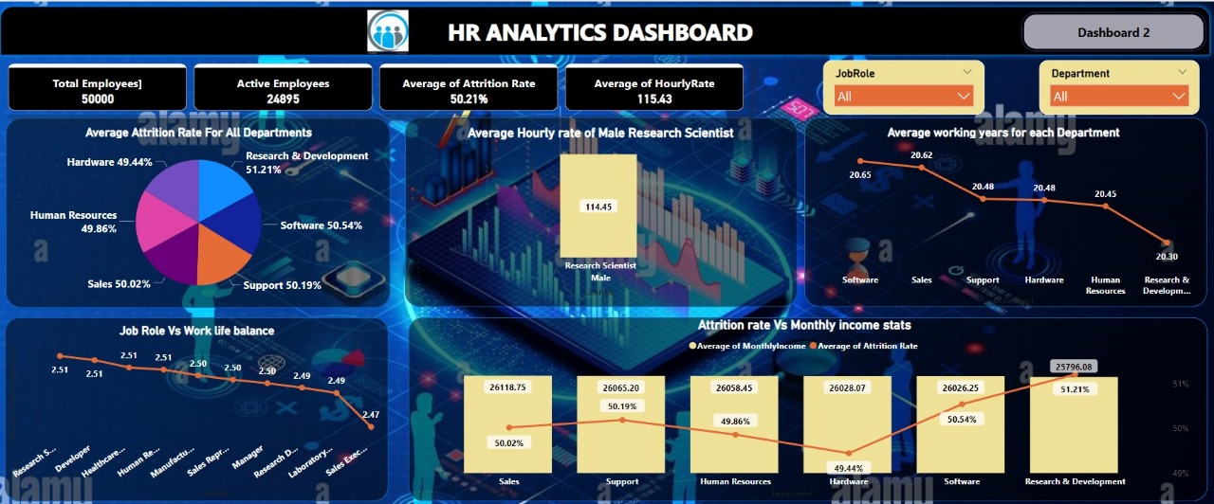

Slide 11
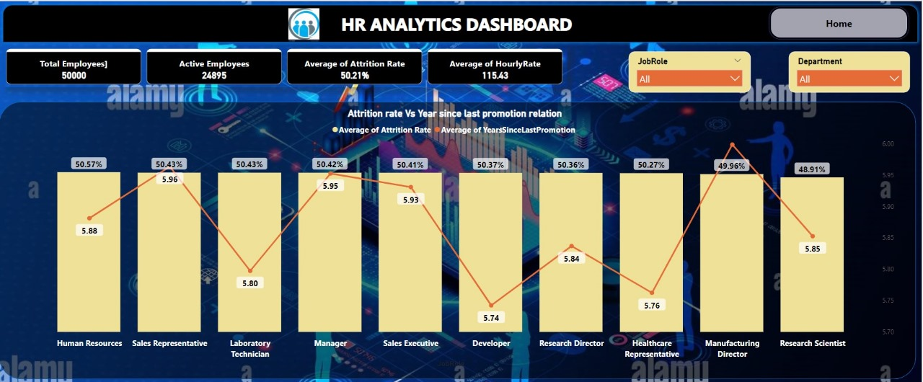

Slide 12
THANK YOU !!!

